Slide 1
Git 101
CFM Hack 2018 (Fall)

Slide 2
Version Control Systems
Software that manages changes that you make to your files (source code)
Track versions of sets of changes to your files
Handles concurrent changes from multiple sources (e.g. different developers working on the same code base)
Typically central repository stores every version of every file

Slide 3
Distributed Version Control (DVCS)
No central server required!
Every user has a copy of every file
So we will use Git, a very popular DVCS
Design goals => Large scale distributed development
Git doesn’t require a server, but it’s common to use one for coordination (i.e. Github)

Slide 4
Concepts
Working directory
Your local copy of the files that you’re working with
Staging area
A “place” where you tell Git to hold a set of changes, temporarily
Repository
A place where Git stores copies of your files and their history

Slide 5
What is the difference between Local Repository and Remote Repository?

Slide 6
Answer:
Local Repository is the copy of repo on your working machine
Remote Repository is the repo on a server (e.g. Github)

Slide 8
Commands
Perform these operations using a Git client (command-line or GUI)
Commands typically move files between working directory, staging area and local or remote repository

Slide 9
Local Commands | Description
git add | Add a file from working directory to staging area
git commit | Commit changes from staging area to repo
git checkout | Get files from repo to working directory
Remote Commands | Description
git clone | Make a copy from remote repo to working directory
git pull | Pull (merge) changes from repo to working directory
git push | Push (merge) changes from staging area to repository

Slide 10
Installing Git
Before anything else, you need to install and configure Git
Install a Git client (command-line or GUI)
https://git-scm.com/downloads
Sign up a github account (tell me your username later)
Setup your email address for Git:
git config –global user.email your_email@example.com

Slide 11
Setup
Get a copy the repository from the server
git clone https://github.com/uwcfm/CFM-HACK-2018.git
Branch off from xxx to create a new copy of repo
git checkout –b your_team_branch_name xxx
One team can share one branch and push commits to the same branch
This can cause merge conflicts sometimes
Solution: one branch per person off from the team branch, then git rebase with the team branch and merge at times (out of scope of this tutorial)

Slide 12
Git rebase (Advance)
One person per branch from the team branch
Git checkout team_branch // switch to team_branch
Git checkout –b team_branch_alex // create your own branch
Git add * // add all changes to staging area
Git commit –m “message about the changes” // commit changes to local repo
Git push origin team_branch_alex // push changes to remote repo
Git checkout team_branch // switch to team_branch
Git pull origin team_branch // make sure you have the latest changes from team_branch
Git checkout team_branch_alex // switch back to team_branch_alex
Git rebase team_branch // rebase team_branch_alex onto team_branch
Git checkout team_branch // switch to team_branch
Git merge team_branch_alex // fast-forward merge team_branch with team_branch_alex

Slide 13
Useful Aliases
Git config –global alias.glog=log --graph --abbrev-commit --decorate --format=format:'%C(bold blue)%h%C(reset) - %C(bold green)(%ar)%C(reset) %C(white)%s%C(reset) %C(dim white)- %an%C(reset)%C(bold yellow)%d%C(reset)' –all
Git glog //shows tree representation for branches

Slide 14
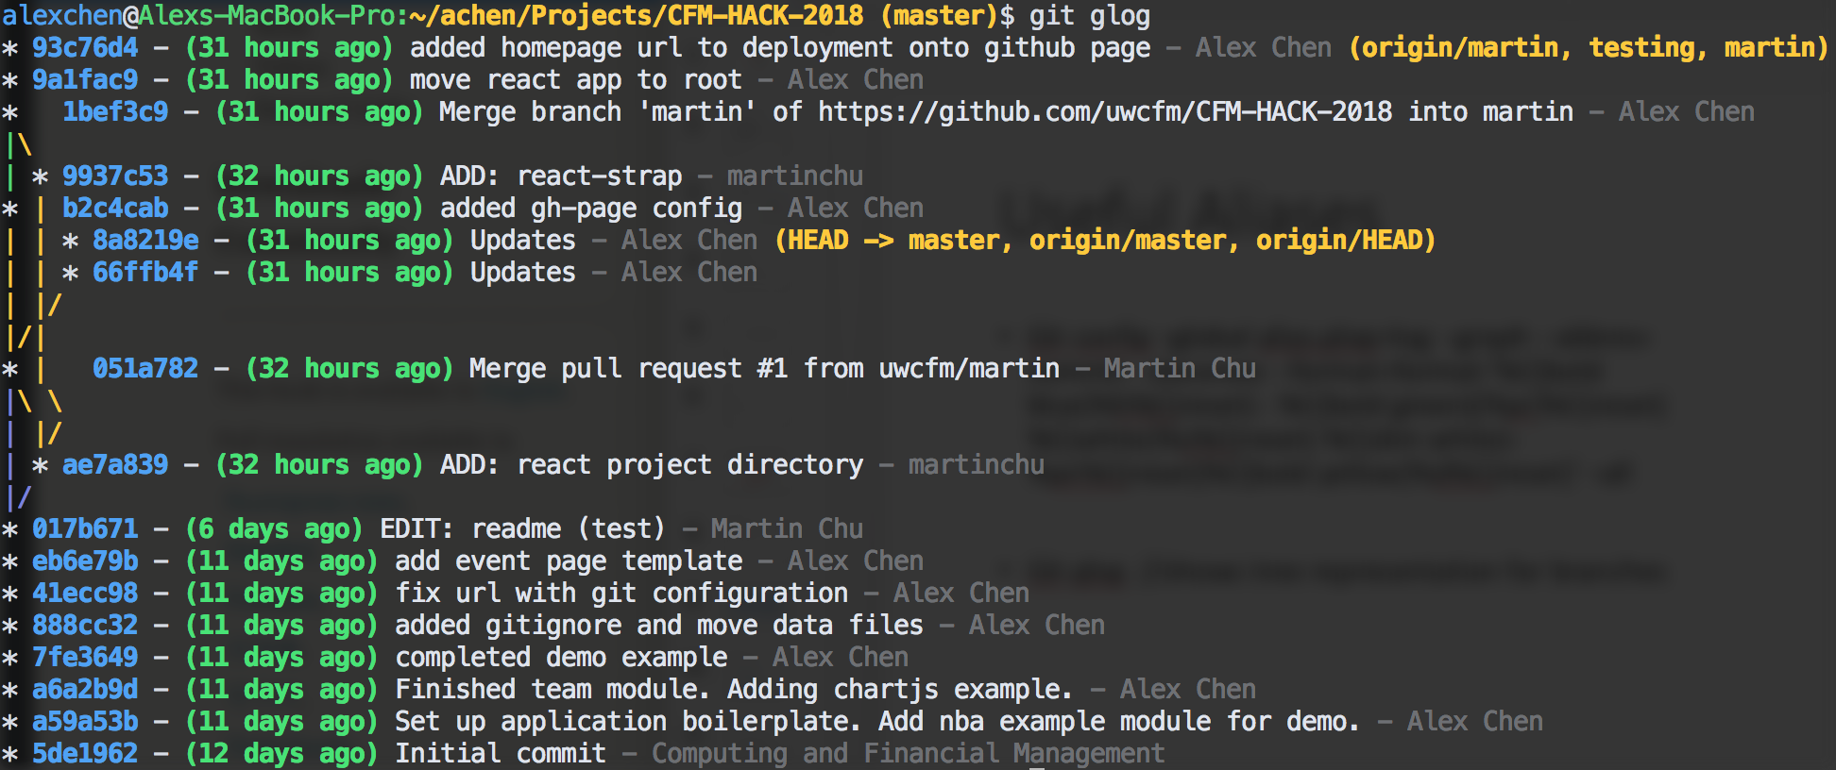

Slide 15
Resources
https://git-scm.com/book/en/v2/Getting-Started-First-Time-Git-Setup
https://www.atlassian.com/git/tutorials
https://git-scm.com/book/en/v2/Git-Basics-Git-Aliases
https://git-scm.com/book/en/v2/Git-Branching-Rebasing

